Slide 1
FINM 35900 Macro Finance
Homework 2 Presentation
Hongsen (Henry) Fu
Huayu (Alaia) Zhu
Mange (Kevin) He
Yuxuan (Ryan) Bai
Notes:
Format:
Theme: white and dark gray
Headline: font 32, Calibri
Main Text: font 18, Calibri
Sidenote: font 14

Slide 2
Part 1:
add
Notes:
[1] Siblis Research. “Total Market Value of U.S. Stock Market.” Siblis Research, 13 Oct. 2020, siblisresearch.com/data/us-stock-market-value/. Accessed 21 Feb. 2024.
[2]The blank space remains to be implemented after the refinement of the strategy.

Slide 3
Part 2:
add
Notes:
[

Slide 4
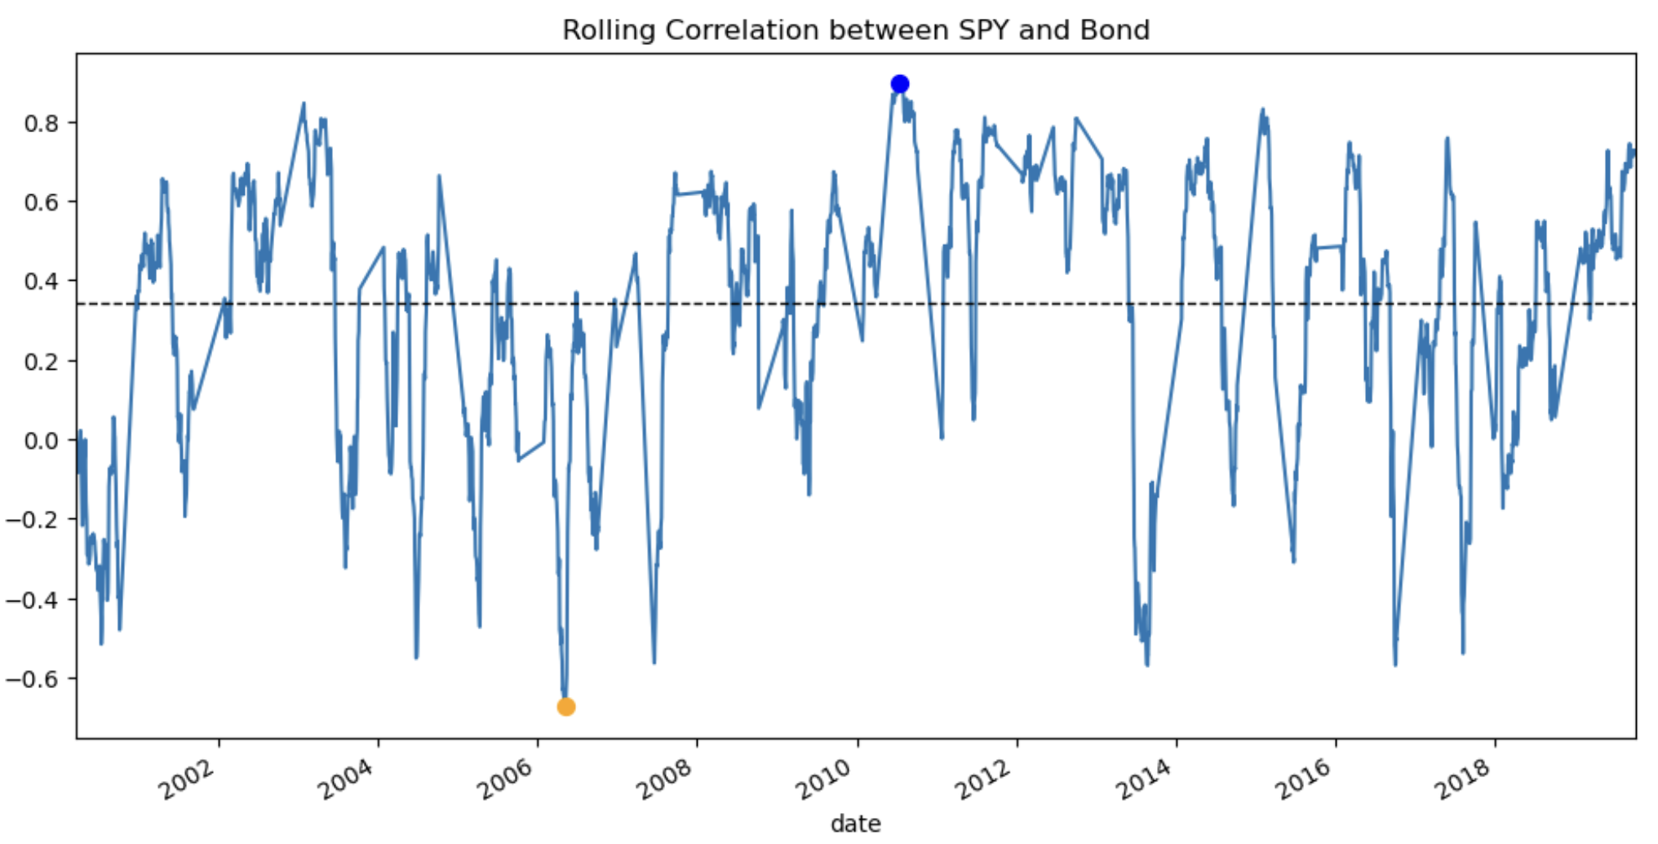
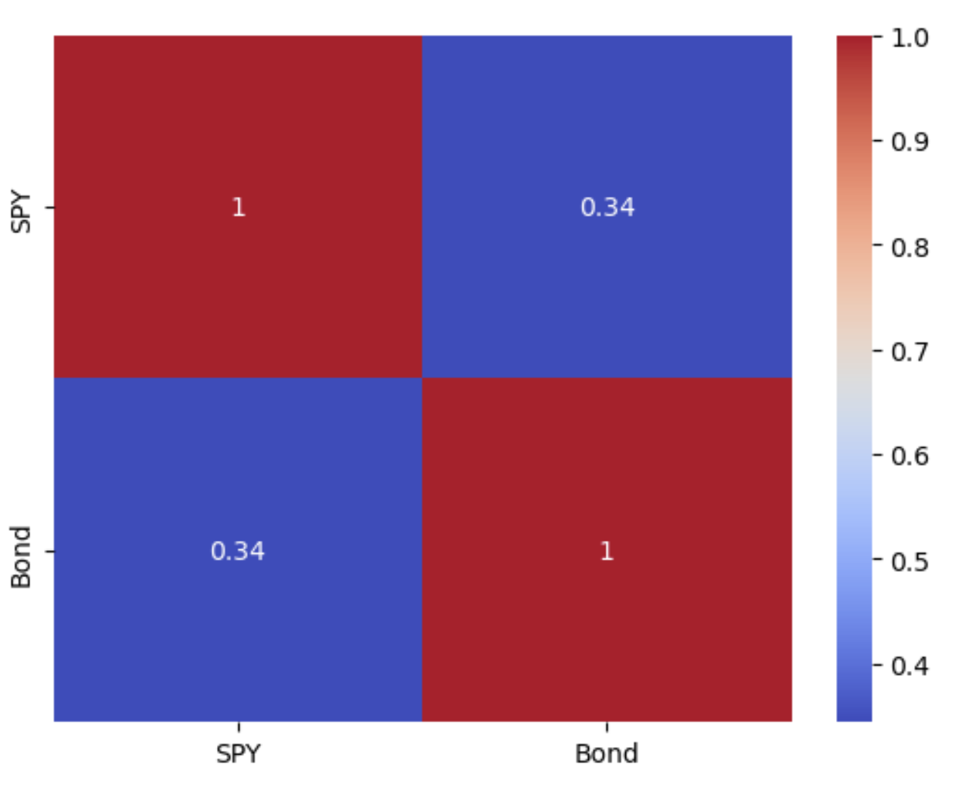
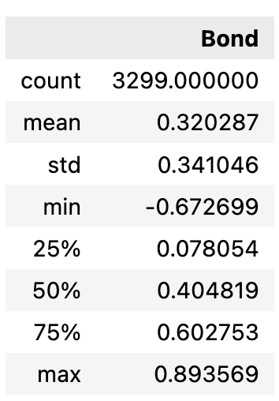
Part 3 Risk Parity:
Data:
Get SPY from quandl
Get US 10 year bond From FRED
Data range (weekly return data ): 01-10 – 2000 to 05-07-2024
8.a correlation analysis:
SPY and 10yr Bond has correlation 0.343921 over 2000-2019.
8.b rolling correlation analysis
Rolling correlation range from a minimum of -0.6727 (2006-05-10) to a maximum of 0.8936 (2010-07-14).
The upper plot of the line plot of rolling correlation.
The left one is the constant correlation map.
The right table shows the statistical summary of rolling correlation.
Notes:
[1] Siblis Research. “Total Market Value of U.S. Stock Market.” Siblis Research, 13 Oct. 2020, siblisresearch.com/data/us-stock-market-value/. Accessed 21 Feb. 2024.
[2]The blank space remains to be implemented after the refinement of the strategy.

Slide 5
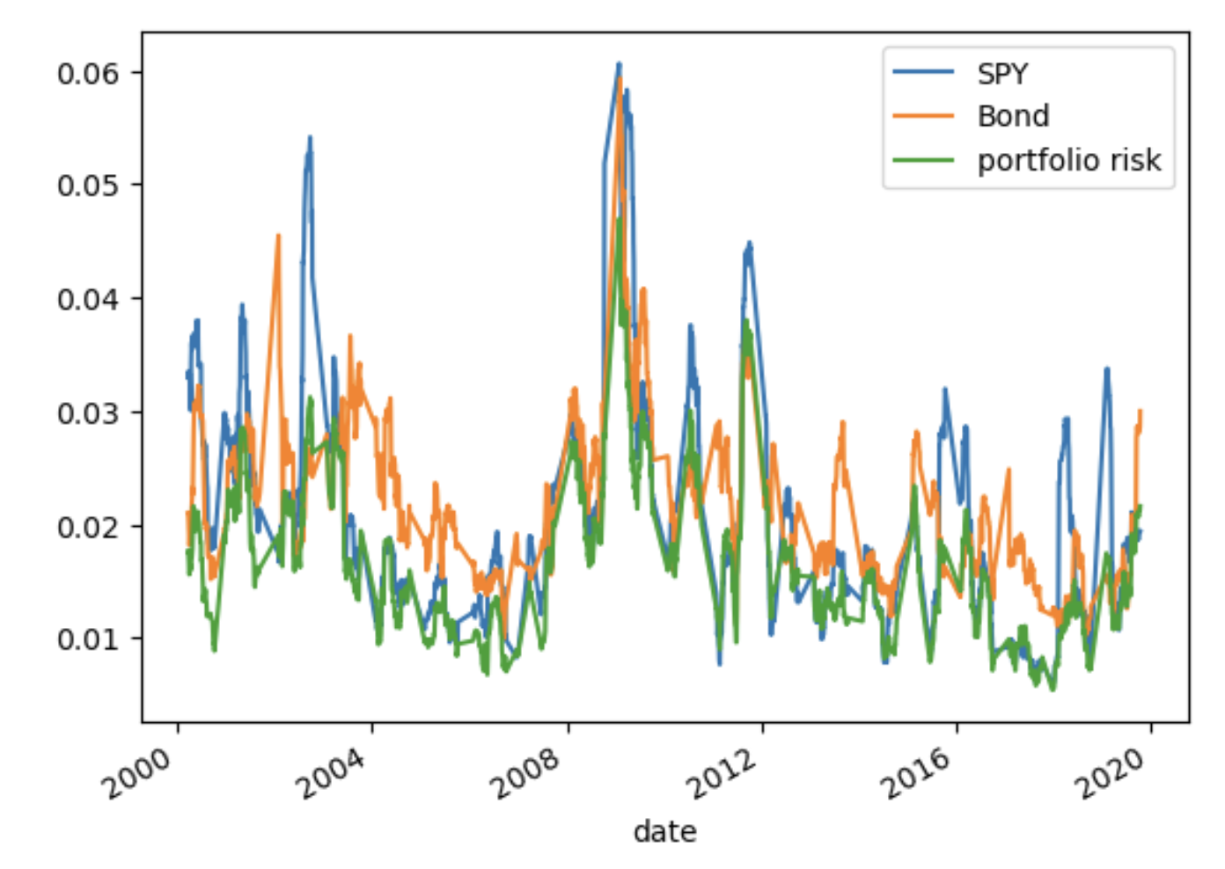
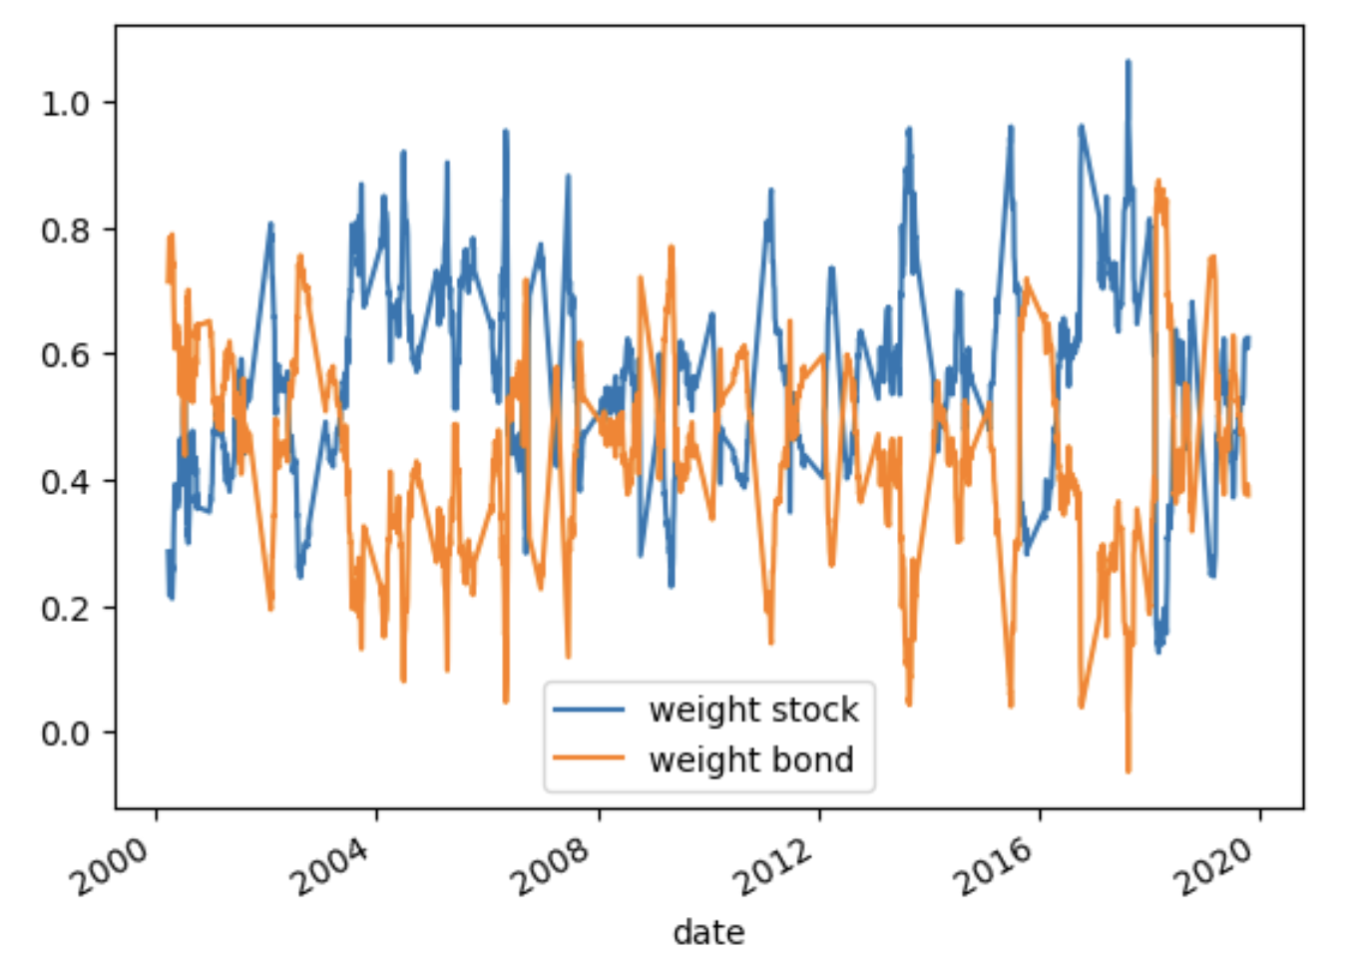
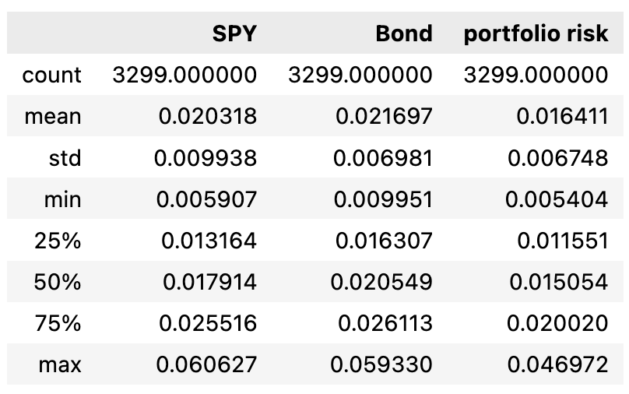
9.a The average weight of the stock (SPY) is 0.556174, and the average weight of the bond(US 10 year) is 0.443826. the allocation weight over time is down below on the right.
9.b The table down below summarizes the volatility of bond and stock, as well as the portfolio risk. The line plot of these three are on the upper right. We utilize the equal weighted risk parity method, therefore, the risk contribution is equal among these two assets.
9.c Reason for using risk parity:
Lower mean risk
Lower std of risk
Successfully lower the overall portfolio risk during time periods when two asset classes have different local maximum.
Notes:
[1] Siblis Research. “Total Market Value of U.S. Stock Market.” Siblis Research, 13 Oct. 2020, siblisresearch.com/data/us-stock-market-value/. Accessed 21 Feb. 2024.
[2]The blank space remains to be implemented after the refinement of the strategy.

Slide 6
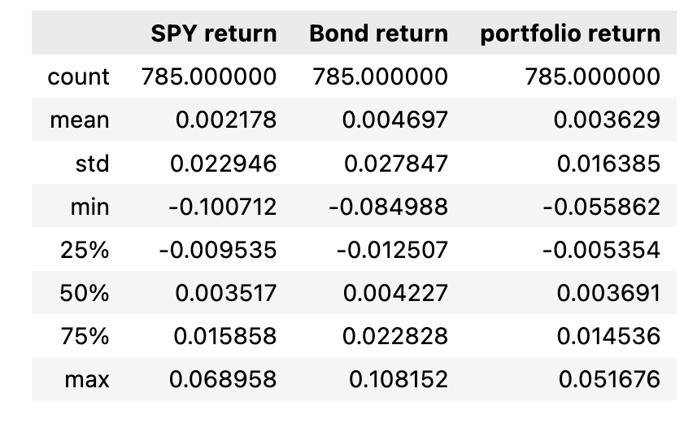
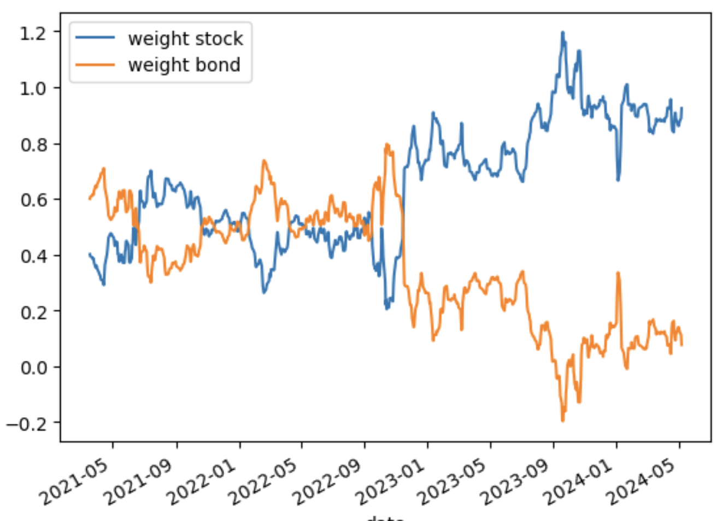
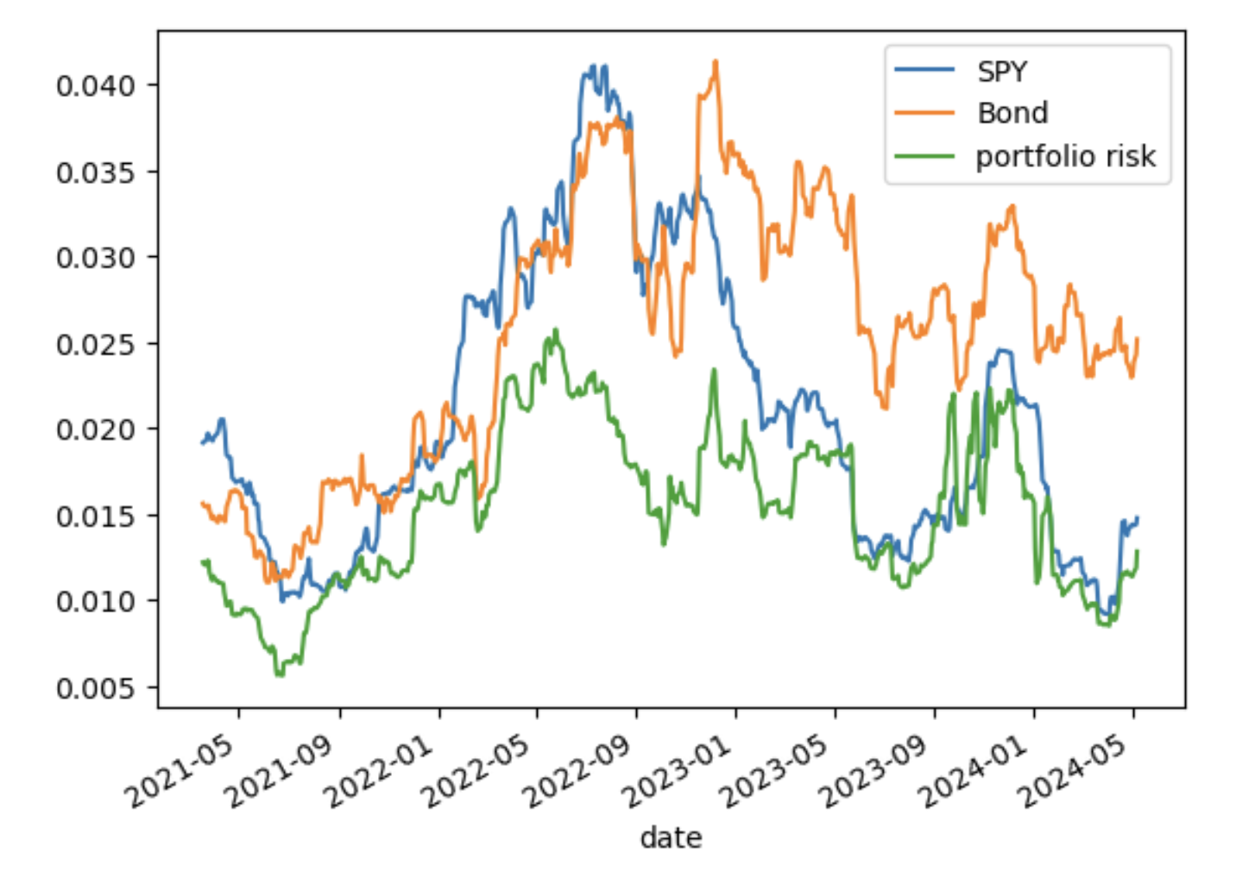
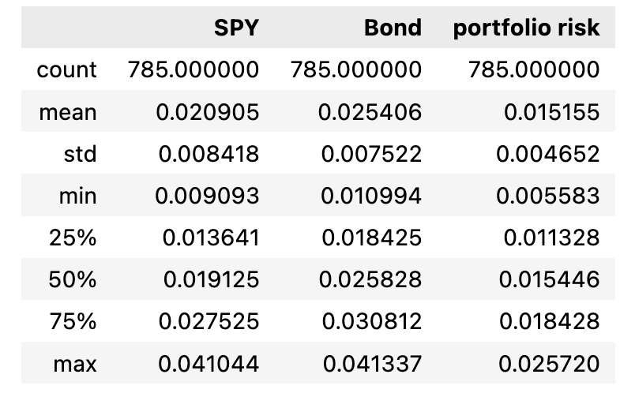
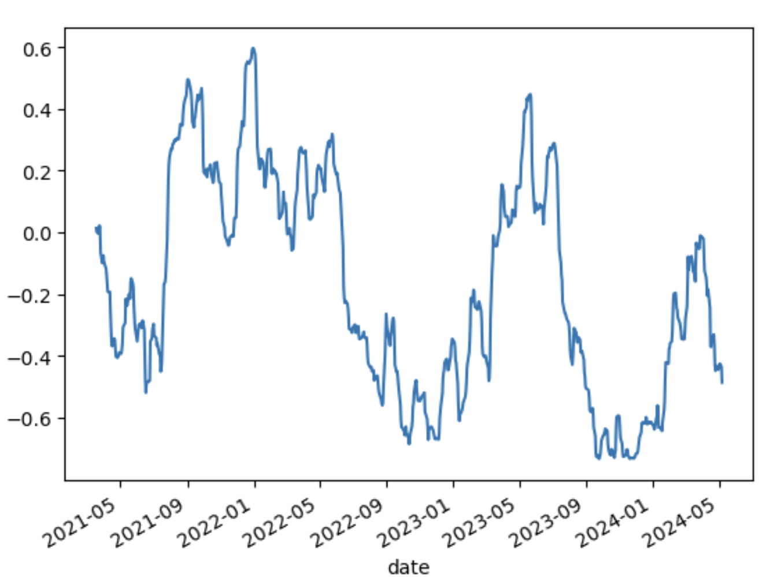
10.a
(0,0) is the summary statistics of return
(0,1) is the weight allocation over time
(1,0) is the line plot of risk analysis
(1,1) is the summary statistics of risk
10.b
The plot downside is the line plot of rolling correlation.
Constant correlation is -0.25682

